Slide 1
Capture and
Replay
An intuitive approach to GUI Testing.
Work done by:
Pedro Reis
Sara Herz

Slide 2
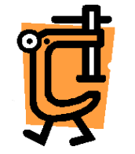
What is a Capture/Replay Tool?
Record and Replay, otherwise known as codeless automation, is a way to run tests on a GUI application, or a web page;
Good for testers without programming knowledge, as many tools generate the tests based on user input;

Slide 3
Advantages of Capture/Replay
Testers may not be developers, due to ease of recording tests in some tools;
Some tools offer object-based recording (good for regression testing);

Slide 4
Disadvantages of Capture/Replay
Requires the GUI to be ready for testing;
May have regression testing problems if the software takes into consideration screen position of input;
Product requirement can change throughout development, and so does the UI. When this happens, tests can break;

Slide 5

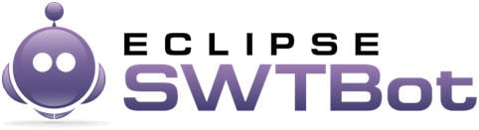

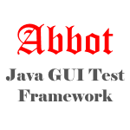

Tools Analysed

Slide 6
QF-Test
Professional automated testing tool for web and Java application’s GUI (Swing and JavaFX);
Easy to use by testers without programming knowledge;
Supports cross-browser testing and provides reusable tests;
Comprehensive documentation
Free, but proprietary;

Slide 7
SWTBot
Java API used to write tests, which makes it very easy to use for Java developers;
Designed for SWT applications exclusively;
Good integration with Eclipse IDE ecosystem;
Has recorder to generate tests;
Free and Open-source!

Slide 8
Selenium
Supports testing for web, cross-browser;
Very easy to install, with a nice GUI;
Widely used and well integrated with CI tools;
Allows tests to be written in C#, Groovy, Java, Perl, PHP, Python, Ruby and Scala;
Free and Open-Source!

Slide 9
Abbot Java GUI Framework
Used to test Java GUI applications;
Provides unit and functional testing for AWT and SWING
Has Record and Replay function;
It consists of GUI references and performs user actions on GUI components;
Provides unit testing and functional testing for AWT and SWING;
Free and Open-Source!

Slide 10
Katalon
Built on top of Selenium;
Specialized IDE interface for API, web and mobile testing;
Main scripting languages is Groovy;
Katalon Recorder is a browser add-on to record user’s actions in web applications and generate test scripts;
Katalon Recorder supports Chrome and Firefox;
Free, but proprietary;

Slide 11
Criteria Utilized for Selection
Ease of Use;
Ease of Install;
Ability to handle regression testing;
Price / license (open-source, free, proprietary, paid);
Cross-platform compatibility (Windows, Linux, or cross-browser for web based apps);

Slide 12
Our choice was...
Selenium!
(but you probably knew that already)

Slide 13

Example video

Slide 14
Conclusion
Capture and replay is an excellent way to create automated GUI tests. Many of the tools can already handle regression testing.
However, the return of investment for these tools is often too low to justify using these methodologies. It demands that GUI itself to be already constructed, and the UI is a very volatile aspect of a product throughout development.

Slide 15

Exercises
Open the Exercises PDF on the repo,
and let’s get to work!

Slide 16
References:
https://www.qfs.de/en/qf-test/testimonials/evaluation-reports/capture-and-replay-tools-for-swing.html#targetText=Capture%20and%20replay%20is%20an,a%20high%20need%20of%20maintenance.&targetText=Often%20manual%20created%20test%20scripts,reduce%20the%20usage%20of%20assets.
https://crossbrowsertesting.com/blog/test-automation/record-and-replay-testing/
https://www.tutorialspoint.com/software_testing_dictionary/capture_replay_tool.htm
https://dzone.com/articles/are-you-confused-between-scripting-testing-and-rec
https://www.softwaretestinghelp.com/best-gui-testing-tools/

